Slide 1
K.RAMAKRISHNAN COLLEGE OF TECHNOLOGY
TRAFFIC PREDICTION MANAGEMENT USING MACHINE LEARNING

Slide 2
GUIDE NAME : PRAVEEN KUMAR.T M.E,(Ph.D).,
Assistant Professor
TEAM MEMBERS:
NAME REGISTER NUMBER
1.SABARI PRIYAN G 811721243044
2.SHAI SHARATH VIJEY S 811721243050
3.NAVEEN KUMAR K 811721243037
4.NEELAMUGESH S 811721243039

Slide 3
ABSTRACT
This project aims to revolutionize urban traffic management through an advanced predictive system. Utilizing robust data analysis and machine learning , our model anticipates traffic patterns , enabling proactive strategies for congestion mitigation and improved urban mobility. Exploring the integration of intelligent traffic management systems with city infrastructure, leveraging sensors, cameras, and IoT devices to enhance real-time monitoring and facilitate adaptive traffic control strategies

Slide 4
INTRODUCTION
In the era of data-driven insights, Machine Learning emerges as a transformative force, empowering systems to learn from experience and improve performance autonomously.
This introduction delves into the dynamic world of Machine Learning, where algorithms evolve with data, enabling computers to discern patterns, make predictions, and adapt to changing scenarios.
As we navigate through the intricacies of this field, the goal is to unravel the potential applications, challenges, and the profound impact that Machine Learning continues to exert on diverse industries, from healthcare to finance and beyond.
In urban landscapes, the escalating challenges posed by traffic congestion demand innovative solutions.
This project delves into the realm of Traffic Prediction Management, seeking to revolutionize urban mobility through the seamless fusion of data analytics and intelligent systems.

Slide 5
LITERATURE SURVEY
S.NO | TITLE | AUTHOR | YEAR | TECHNIQUES USED | ADVANTAGE | LIMITATIONS
1. | Predicting Traffic for Intelligent Transport System the Using Machine Learning Algorithms | Sai Akshita Kanaparthy, Raveena Reddy Vemula, Sai Niyathi Padakant | 2022 | In this paper, different machine algorithms are employed for achieving higher efficiency and accurate results. To identify classification and regression, Decision Tree Algorithm (DT)is used. Based on the parameters supplied, it's a graphical depiction of all possible solutions to a problem/decision. | Machine learning algorithms can analyze historical and real-time traffic data to predict congestion, enabling better traffic management and optimization of traffic flow. | Decision trees can be difficult to interpret and explain, particularly as the complexity of the model increases. This can make it challenging to communicate the results of the model to stakeholders, which is essential in traffic prediction for effective decision-making.
2. | Prediction of HDD Failures by Ensemble Learning | Narendran, Monishraj, Dr. Sathya Srivinas | 2022 | In traffic prediction, ensemble learning can be applied in several ways. For example, different models can be trained on different subsets of data, and their predictions can be combined to produce an overall prediction | Ensemble learning techniques combine multiple predictive models to improve detection of subtle patterns signaling potential HDD failures, enabling early intervention to minimize data loss and downtime. | Ensemble learning in traffic prediction can increase computational complexity due to training multiple models and may reduce interpretability, making it harder to understand the prediction process.

Slide 6
S.NO | TITLE | AUTHOR | YEAR | TECHNIQUES USED | ADVANTAGE | LIMITATIONS
3. | Traffic Data prediction in Intelligent Transportation System using m-KNN algorithm and Principle Component Analysis. | P.Pavithra , R.Vadivel | 2021 | System employed m-KNN (Modified k Nearest Neighbour algorithm) as a classification model and PCA (Principle Component Analysis) is used for Feature Extraction. Road traffic prediction is a critical component in modern smart transportation systems | The m-KNN algorithm, a modified version of the k-Nearest Neighbors algorithm, enhances prediction accuracy by considering multiple neighbors with varying weights. This is particularly advantageous in traffic data prediction, where subtle patterns and variations require a robust and accurate model. | The main difficulty encountered in dealing with problems of text mining is caused by the vagueness of natural language.
4. | Traffic Prediction for Intelligent Transportation System using Machine Learning. | Gaurav Meena, Deepanjali Sharma, Mehul Mahrishi | 2020 | To identify classification and regression we have used a Decision Tree Algorithm (DT).The goal of this method is to predict the value of the target variables. Decision tree learning represents a function that takes as input a vector of attributes value and return a ”Decision ” a single output value. | Machine learning models enable the proactive prediction of traffic conditions, allowing for timely intervention and the implementation of adaptive traffic management strategies to alleviate congestion and improve overall traffic flow. | Decision trees are prone to overfitting on traffic data. They lack robustness and may not provide accurate predictions on new, unseen traffic patterns.

Slide 7
S.NO | TITLE | AUTHOR | YEAR | TECHNIQUES USED | ADVANTAGE | LIMITATIONS
5. | Machine Learning Methods for Traffic Prediction in Dynamic Optical Networks with Service Chains. | Daniel Szostak and Krzysztof Walkowiak | 2019 | Dynamic Optical Networks (DONs) are being increasingly used in traffic prediction due to their ability to provide high bandwidth and low-latency communication. They enable efficient and reliable data transfer, which is essential for traffic prediction systems to work effectively. | Machine learning methods facilitate the dynamic adaptation of traffic prediction models to changing conditions in optical networks. This adaptability is essential for predicting and managing traffic variations associated with diverse service chains and evolving network configurations. | DONs may not be scalable enough to handle large- scale traffic prediction problems, as they rely on complex optical components and may require significant computational resources.

Slide 8
EXISTING SYSTEM
1.Data Collection:
Traffic Cameras: Video feeds from cameras placed at intersections or along highways provide real-time visual information about traffic conditions.
Inductive Loop Sensors: These sensors are embedded in road surfaces and detect the presence of vehicles by measuring changes in inductance.
GPS and Mobile Data: Aggregated data from GPS devices and mobile phones help in tracking the movement of vehicles and estimating traffic flow.
2.Machine Learning and Data Analysis:
Historical Data: Analyzing historical traffic patterns helps identify regularities and trends.
Feature Extraction: Relevant features like time of day, day of the week, weather conditions, and special events are extracted to improve prediction accuracy
Machine Learning Algorithms: Algorithms, such as neural networks, support vector machines, and decision trees, are used to predict traffic conditions based on historical and real-time data.

Slide 9
3.Real-Time Monitoring:
Dynamic Updating: Systems continuously update predictions based on the most recent data, ensuring accuracy in real-time scenarios.
Incident Detection: Algorithms can identify and respond to unexpected events such as accidents or road closures.
4. Integration with Traffic Management Systems:
Adaptive Traffic Signal Control: Some systems integrate with traffic signal control systems to optimize signal timings based on predicted traffic conditions.
Dynamic Route Guidance: Systems may provide real-time route recommendations to drivers based on current and predicted traffic conditions.
5.Communication Infrastructure:
V2X Communication: Vehicle-to-Everything communication allows vehicles to share data with each other and with infrastructure, enabling more accurate predictions.

Slide 10
PROPOSED SYSTEM
1.Smart Traffic Lights:
Implement adaptive traffic signal control systems that adjust signal timings based on real-time traffic conditions.
Integrate sensors to detect the presence of vehicles, pedestrians, and cyclists at intersections
2.Predictive Analytics:
Use machine learning algorithms to predict traffic patterns and congestion based on historical data, current conditions, and external factors (weather, events, etc.).
Provide real-time updates and predictions to drivers through mobile apps, electronic signage, and other communication channels
3.Public Transportation Integration:
Integrate public transportation data into the traffic management system to coordinate schedules, optimize routes, and enhance the efficiency of public transit.

Slide 11
4.Intelligent Transportation Systems (ITS):
Deploy a network of connected devices, such as cameras, sensors, and communication infrastructure, to monitor and manage traffic.
Utilize Vehicle-to-Everything (V2X) communication to enable vehicles to communicate with each other and with infrastructure.
5.Dynamic Route Guidance:
Offer real-time route recommendations to drivers based on current and predicted traffic conditions.
Consider alternative routes and modes of transportation to optimize the overall traffic network
6.Crowdsourced Data:
Incorporate data from crowdsourced navigation apps to enhance real-time information about traffic conditions.
Encourage user participation to report incidents, road hazards, and other relevant information.
7.Incident Detection and Management:
Implement algorithms to detect and respond to incidents such as accidents, road closures, or construction.
Provide automated alerts to authorities and drivers, offering alternative routes and information about the incident.

Slide 12
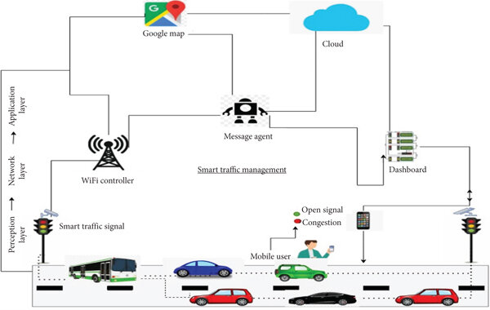
ARCHITECTURE DIAGRAM

Slide 13
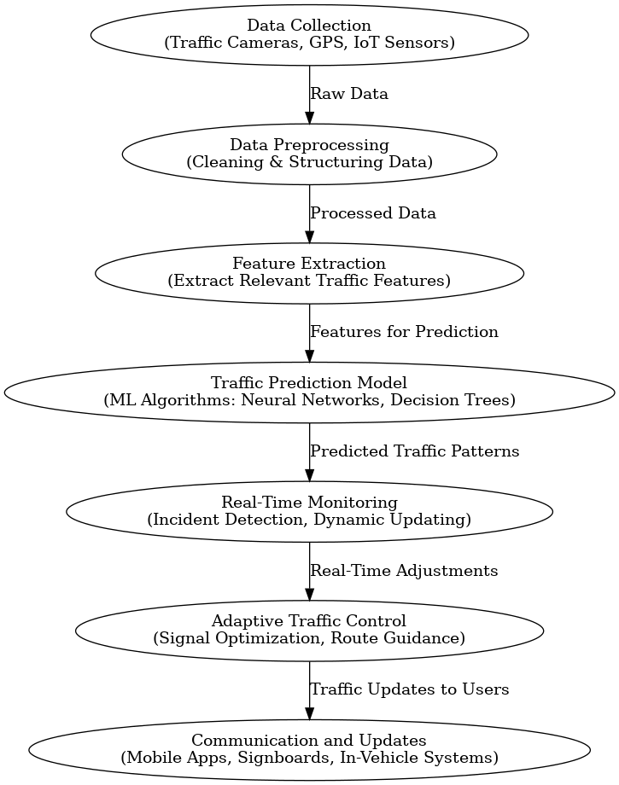
FLOWCHART:

Slide 14
CONCLUSION
In the evolving landscape of data-driven solutions, Machine Learning continues to play a pivotal role, transforming systems and enabling them to make informed decisions autonomously.
This project has explored the application of Machine Learning within the realm of Traffic Prediction Management, demonstrating the potential of predictive models to foresee traffic patterns and enhance urban mobility.
Through a detailed examination of the challenges and intricacies of traffic management, this study has highlighted the impact of machine learning in addressing congestion, optimizing traffic flow, and reducing delays.
By leveraging real-time data and sophisticated algorithms, this system exemplifies the possibilities for smarter, more efficient transportation systems in urban environments.
As we look to the future, this project underscores the importance of continued research and innovation in Machine Learning to build intelligent systems that adapt to ever-changing urban landscapes, providing sustainable solutions for modern mobility challenges.

Slide 15
THANK YOU

